Slide 1
CIS 5810 Final Project Face Swapping
Shiwei Ge
Jiawei He

Slide 2

Agenda
- Source and Destination
- Landmarks of images
- Triangulation
- Extract and warp triangles
- Triangles linking
- Seamless Clone

Slide 3
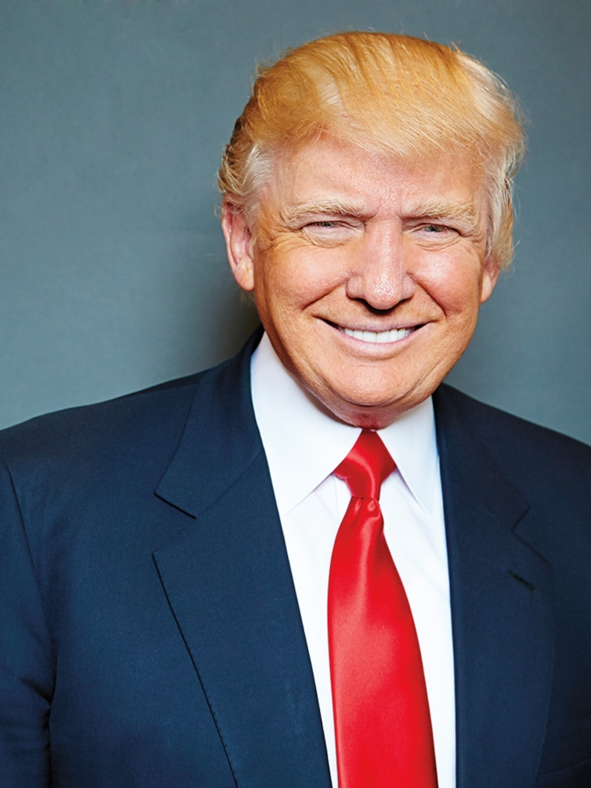
Introduction
In today’s presentation, we are going to introduce how we completed the face swapping application step by step. The result will be put Joe Biden’s face on Trump’s picture or video, which sounds exciting!

Slide 4
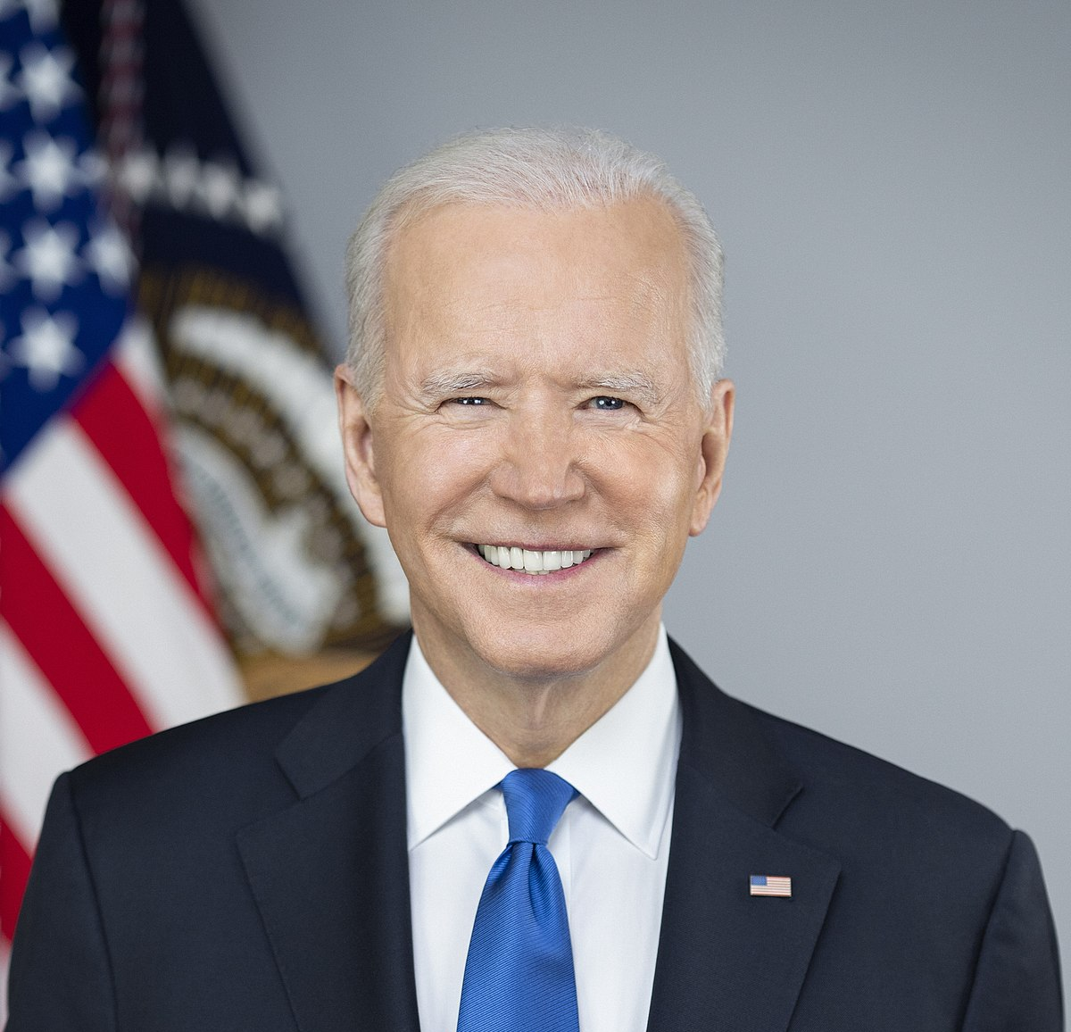



Face Swapping Between Images
Source Image
Destination Image

Slide 5

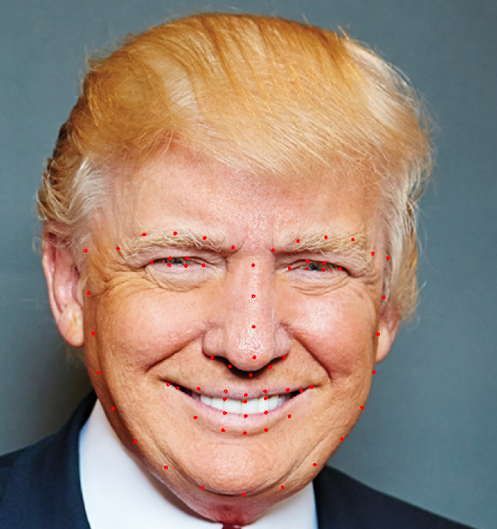
Source and Destination
Source Image Landmarks
Destination Image Landmarks

Slide 6
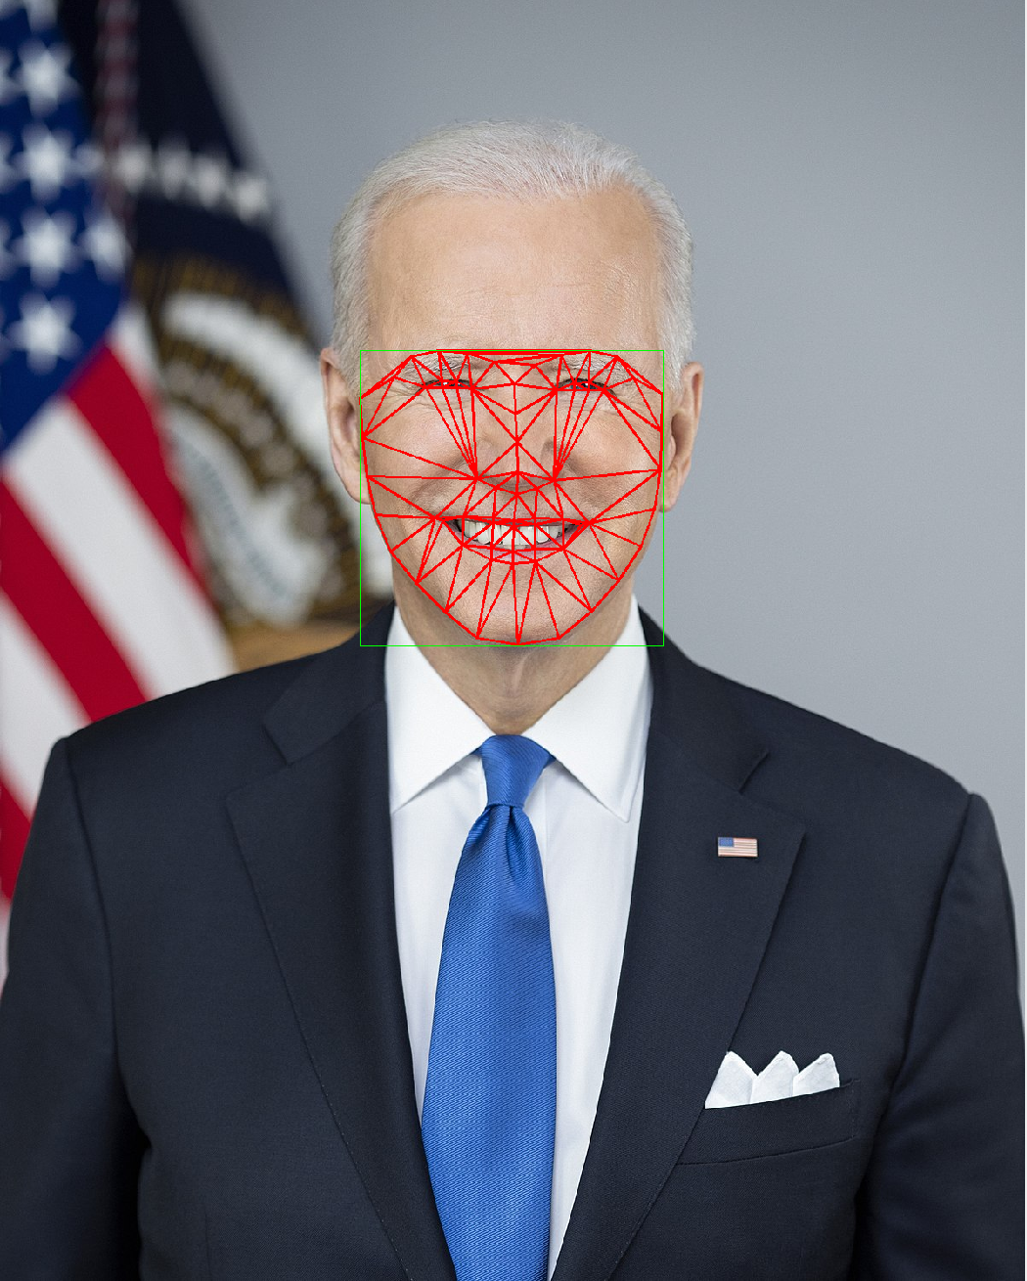
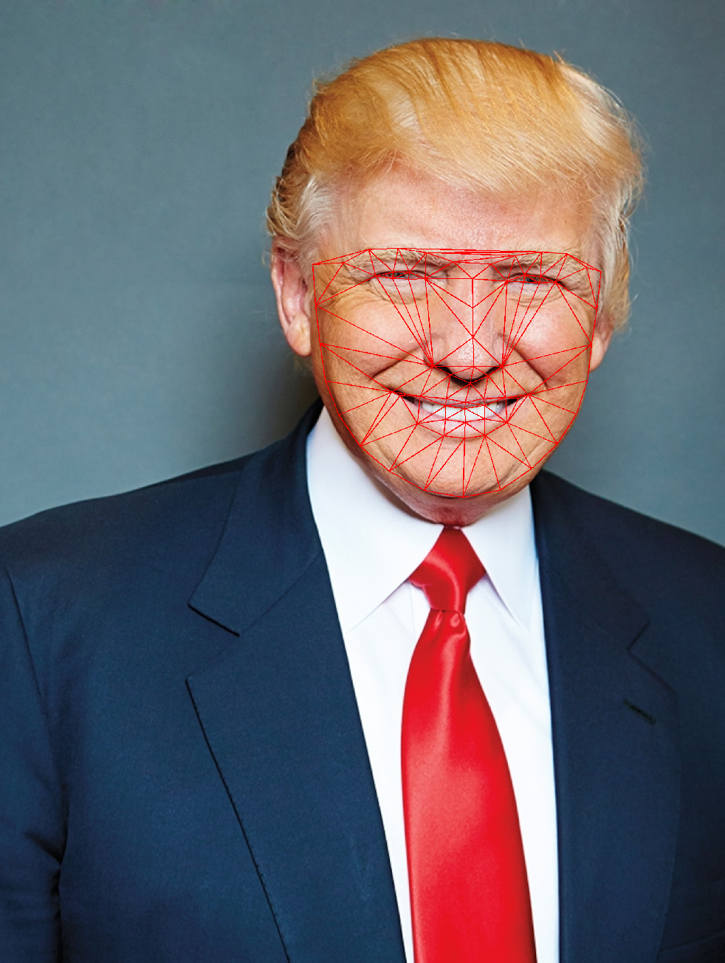
Triangulation
Source Image Landmarks
Destination Image Landmarks

Slide 7
Link Triangles and replace
Source Image Landmarks
Destination Image Landmarks

Slide 8
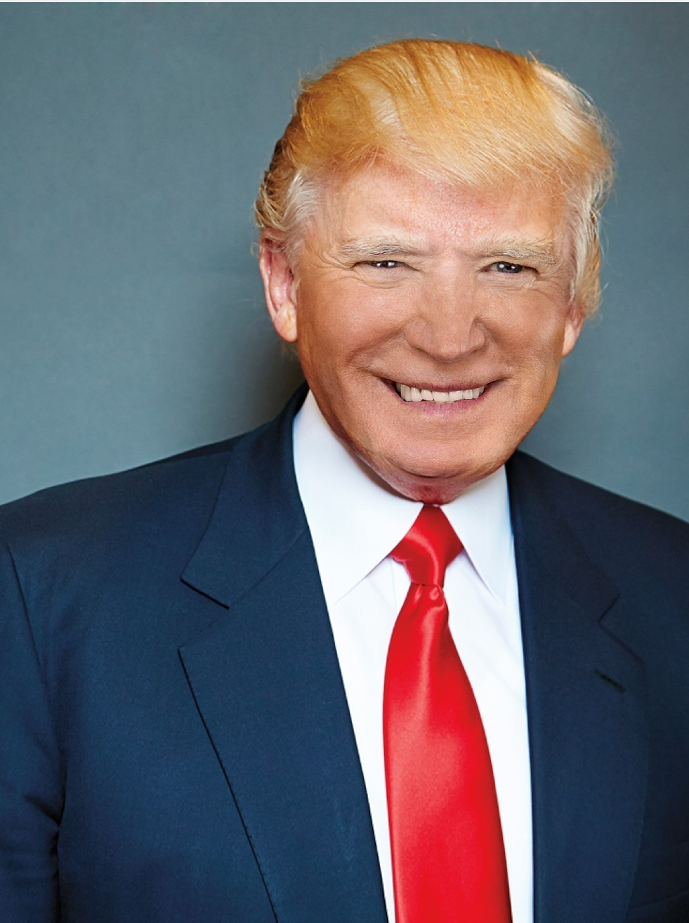
Seamless cloning

Slide 9
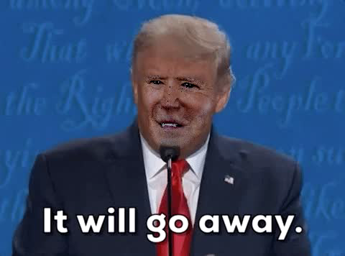
FACE SWAPPING in Video
The same technique as image swapping, just replace each frame of the video with the face of source image
Check out the result on the right panel

Slide 10



Summary
During the process of building the application, we learned a lot about open cv and the detailed steps for face swapping such as landmarks, triangulation, linking, face detector etc. What’s even more exciting is that we build the whole application into a one simple command line. The users only need to type input image and output video or image, then it starts to fire up.

Slide 11




Thank you

